Slide 1






Car Sales Analysis Project
Group “ A ”
Presented to Eng: Abdullah Mostafa
Developed by
Ahmed
Mansour
Hagar
Ayman
Nancy
Elokdah
Passant
Ali
Mahmoud Elwakeel

Slide 2

Agenda:
Week 1:
1- Car_Sales Schema & ERD Diagram.
2- Database Creation.
3- Data Analysis by SQL.
4- Data Analysis by Python.
5- Data Visualization by Python.
Week 2:
1- Set of Analysis Questions.
2- Questions Answering by SQL.
3- Questions Answering by Python.

Slide 3
Week 1
Cleaned dataset ready for analysis.
Data preprocessing notebook.

Slide 4
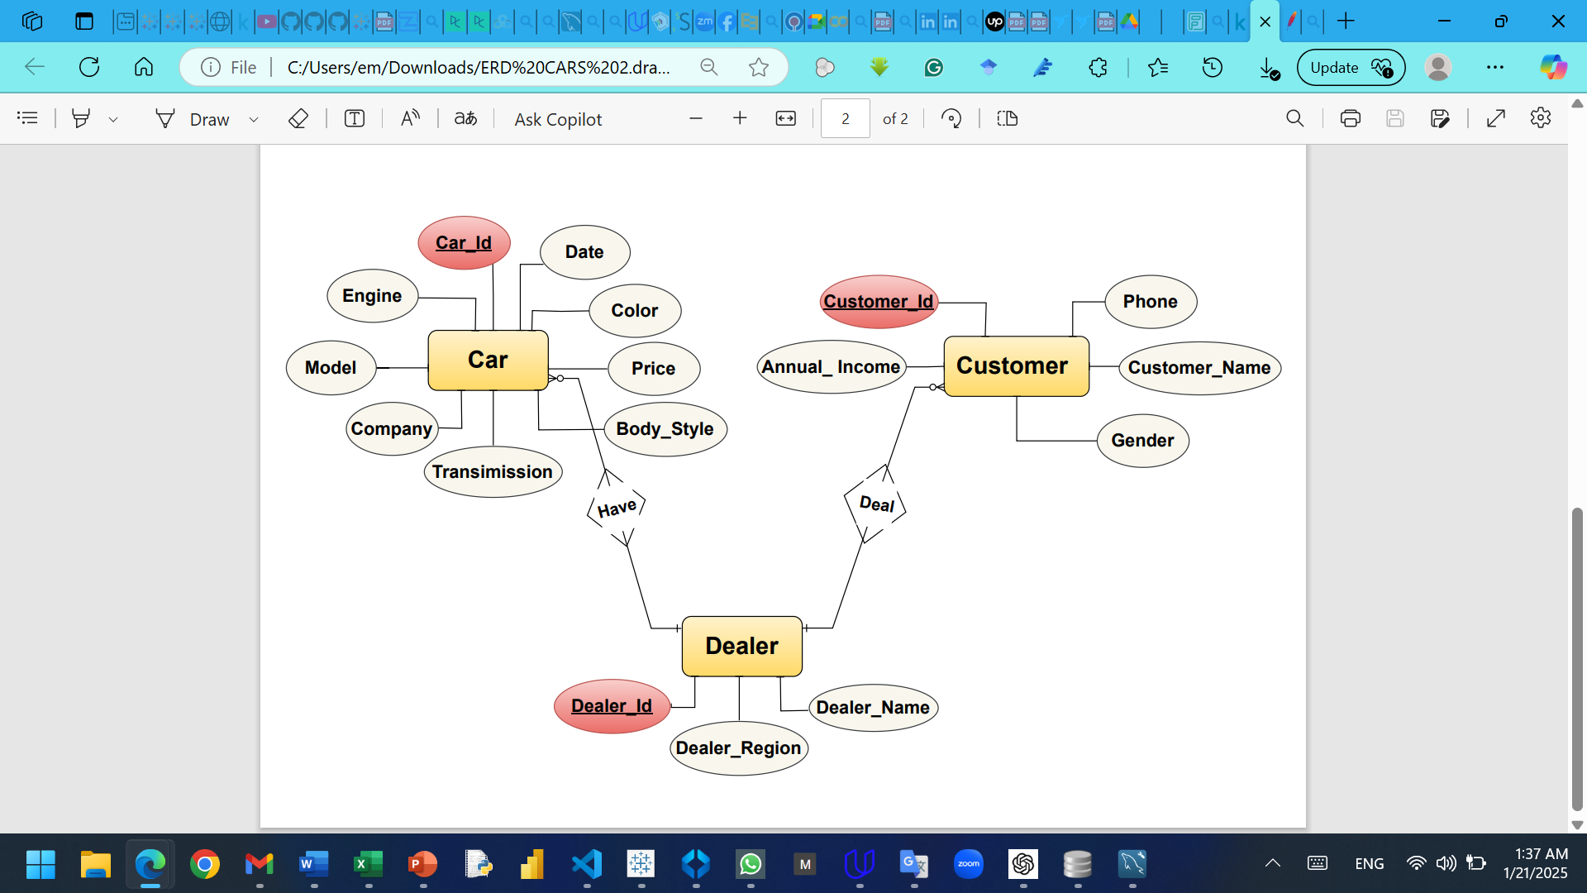
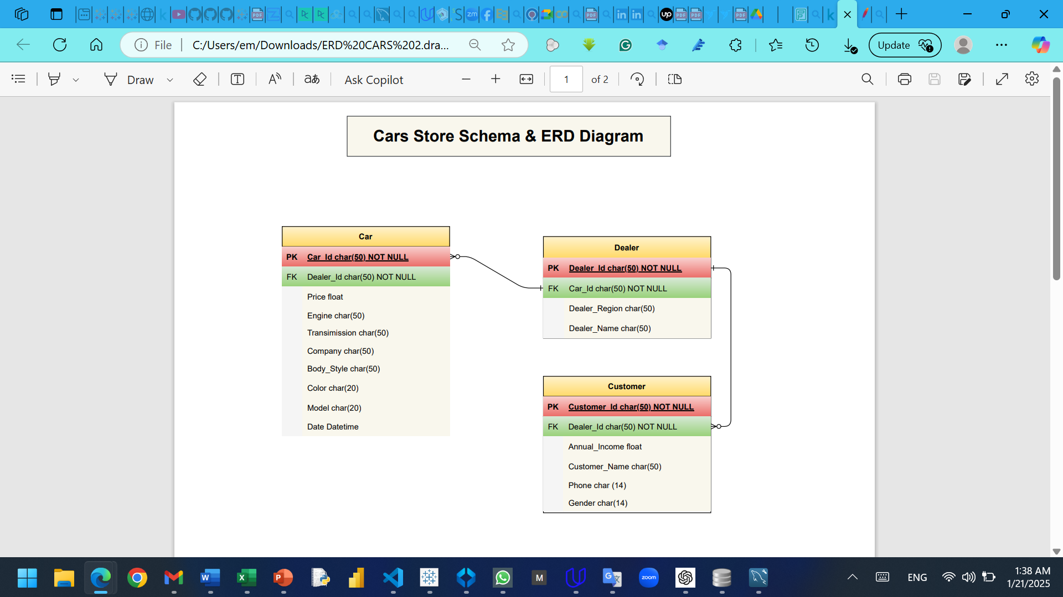
Car_Sales Schema & ERD Diagram

Slide 5
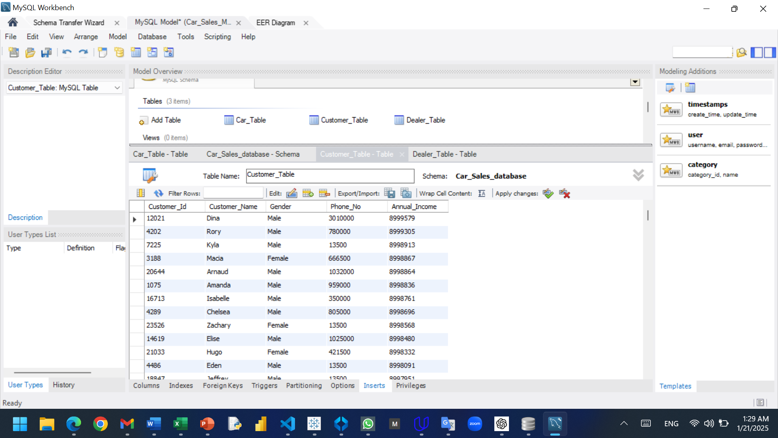
Database Creation

Slide 6
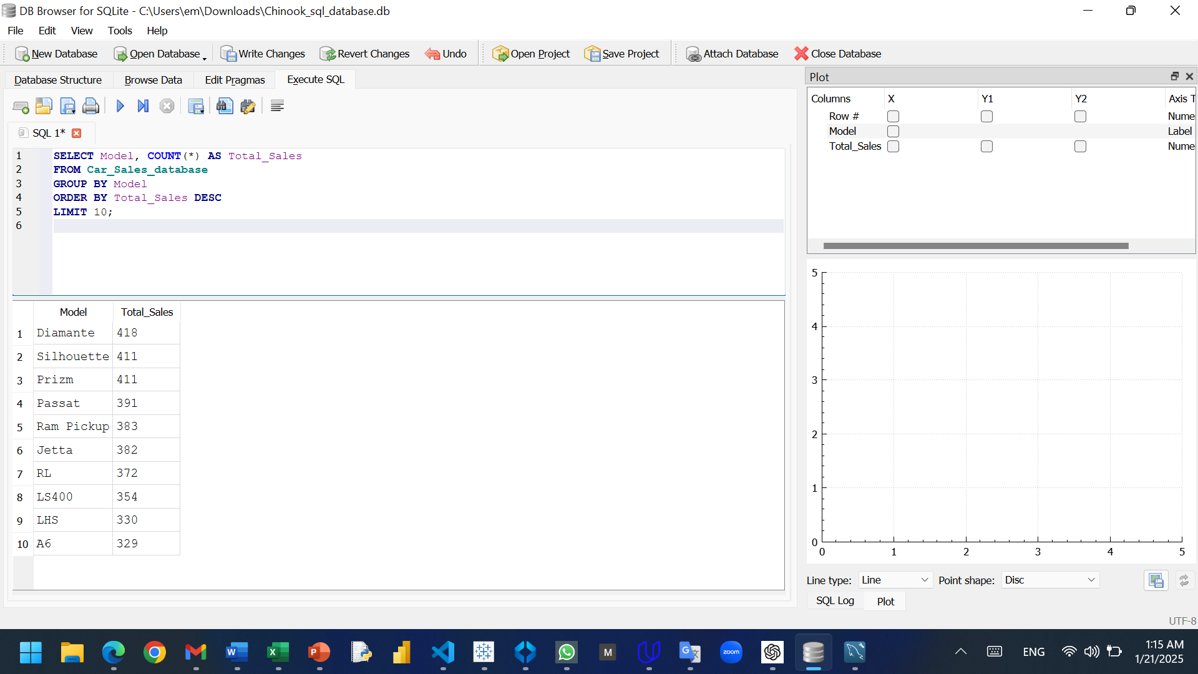
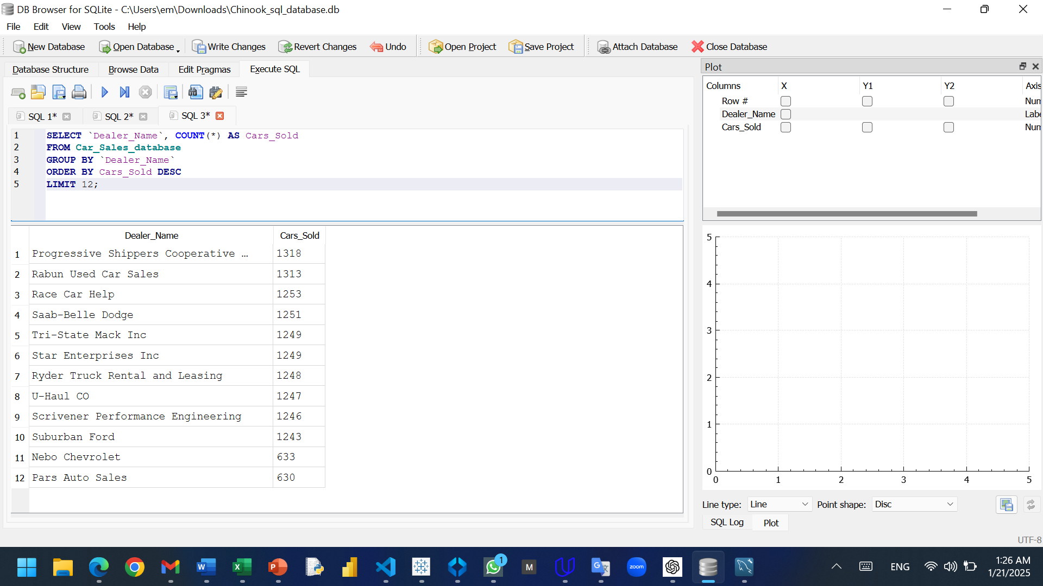
Data Analysis by SQL
Total Sales by Model
Top 12 Dealers who sold the most cars

Slide 7
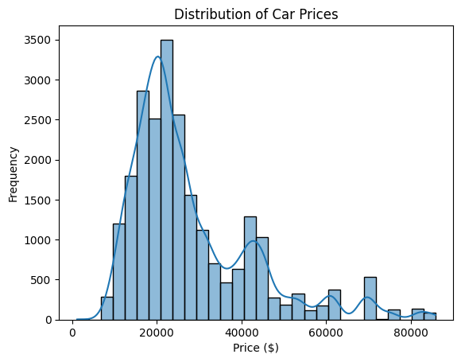
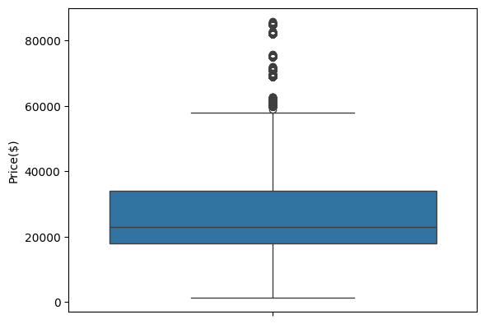
Data Visualization by Python

Slide 8
Week 2
Set of analysis questions that can be answered via the dataset.

Slide 9
Proposed Questions
Sales Performance Analysis
What is the total revenue generated from car sales?
How do sales trends change over time (monthly, quarterly, yearly)?
Customer Analysis
Is there a correlation between a customer’s annual income and the price of the car purchased?
What is the gender distribution of customers buying cars?
Dealer Performance Analysis
Which dealer has the highest revenue?
What is the average number of cars sold per dealer?
Market Trends & Insights
Which dealer region contributes the most to total sales?
What are the most popular car colors among buyers?
Are there seasonal trends in car sales?

Slide 10
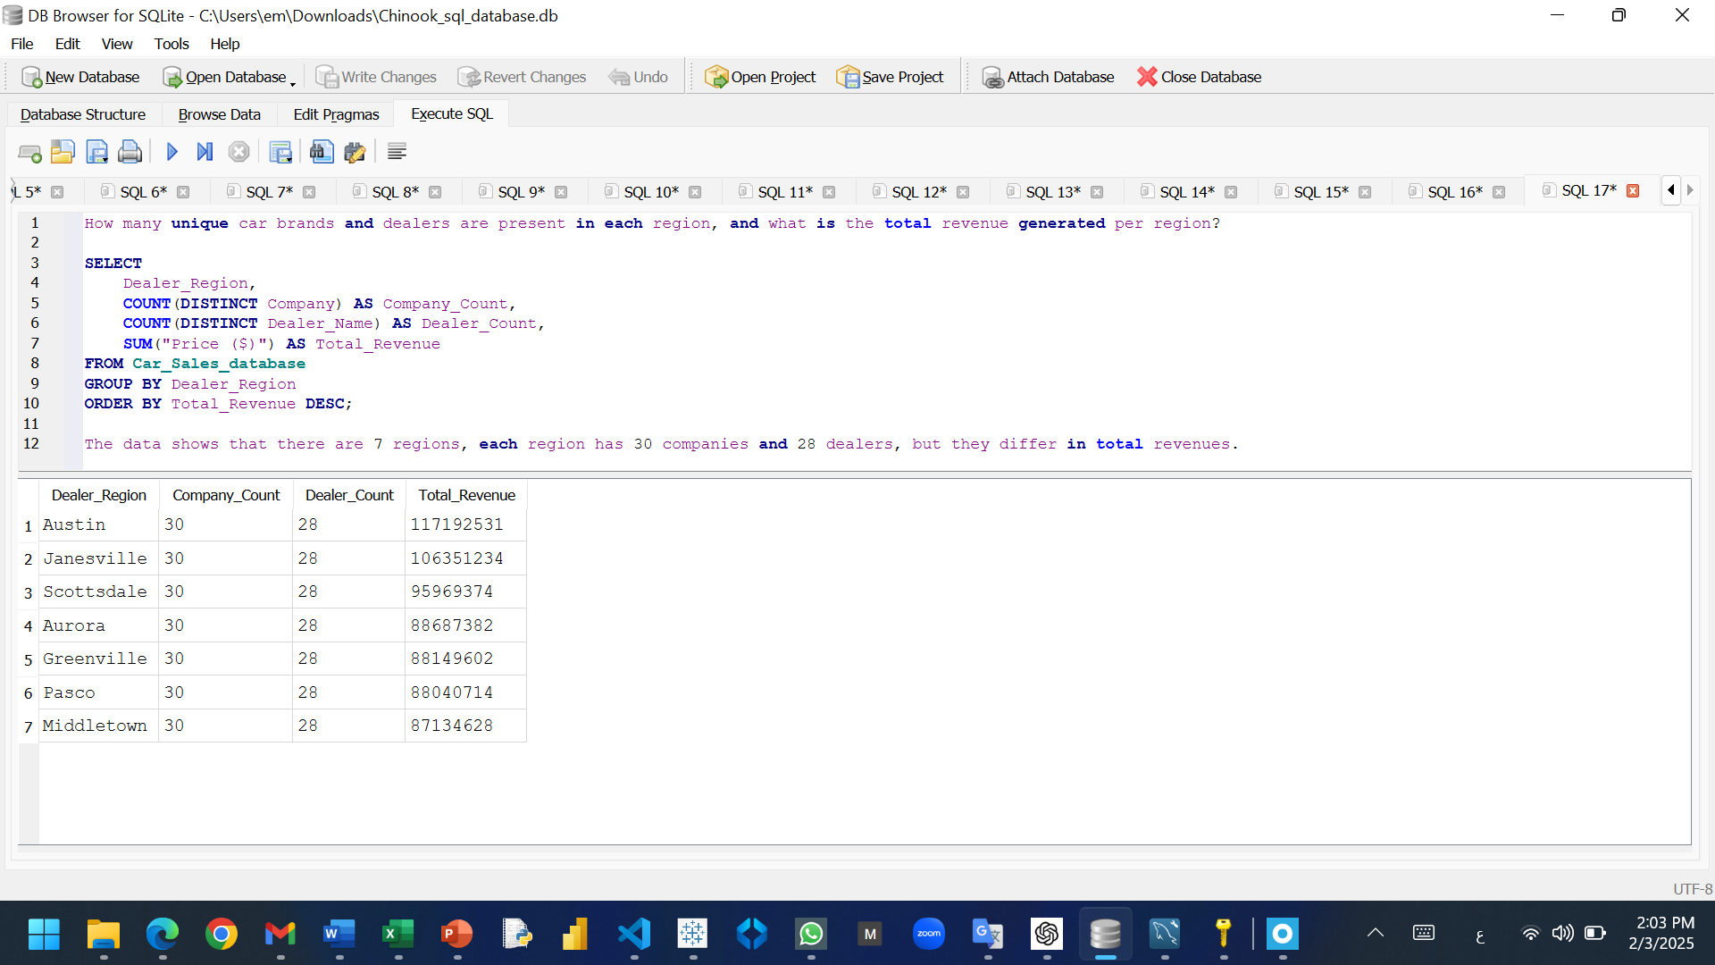
Questions Answering by SQL.

Slide 11
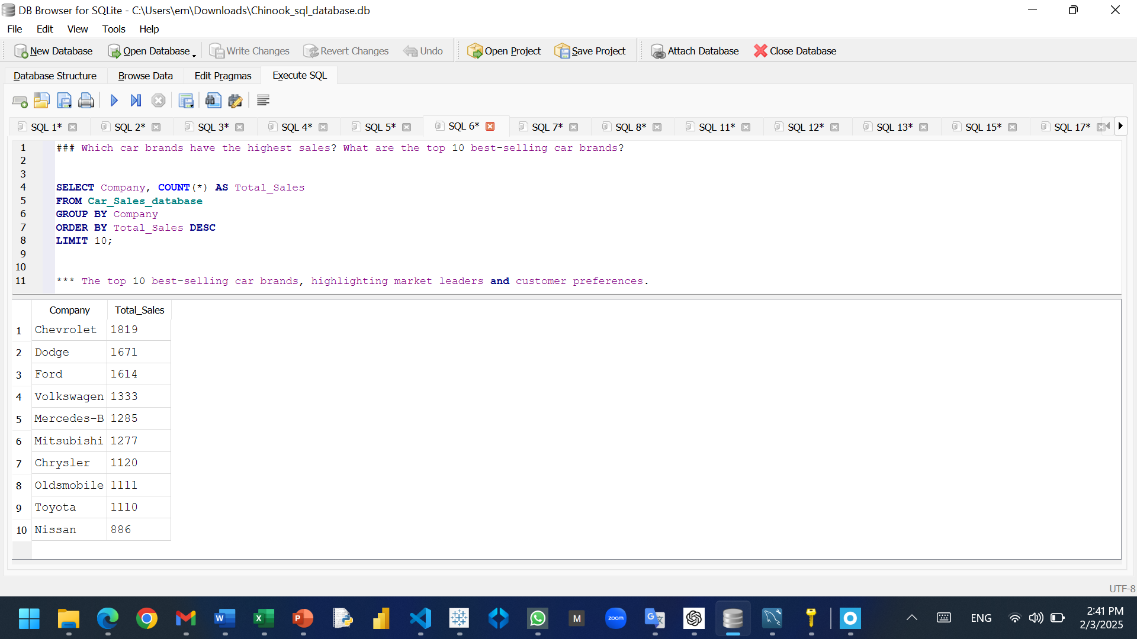
Questions Answering by SQL.

Slide 12
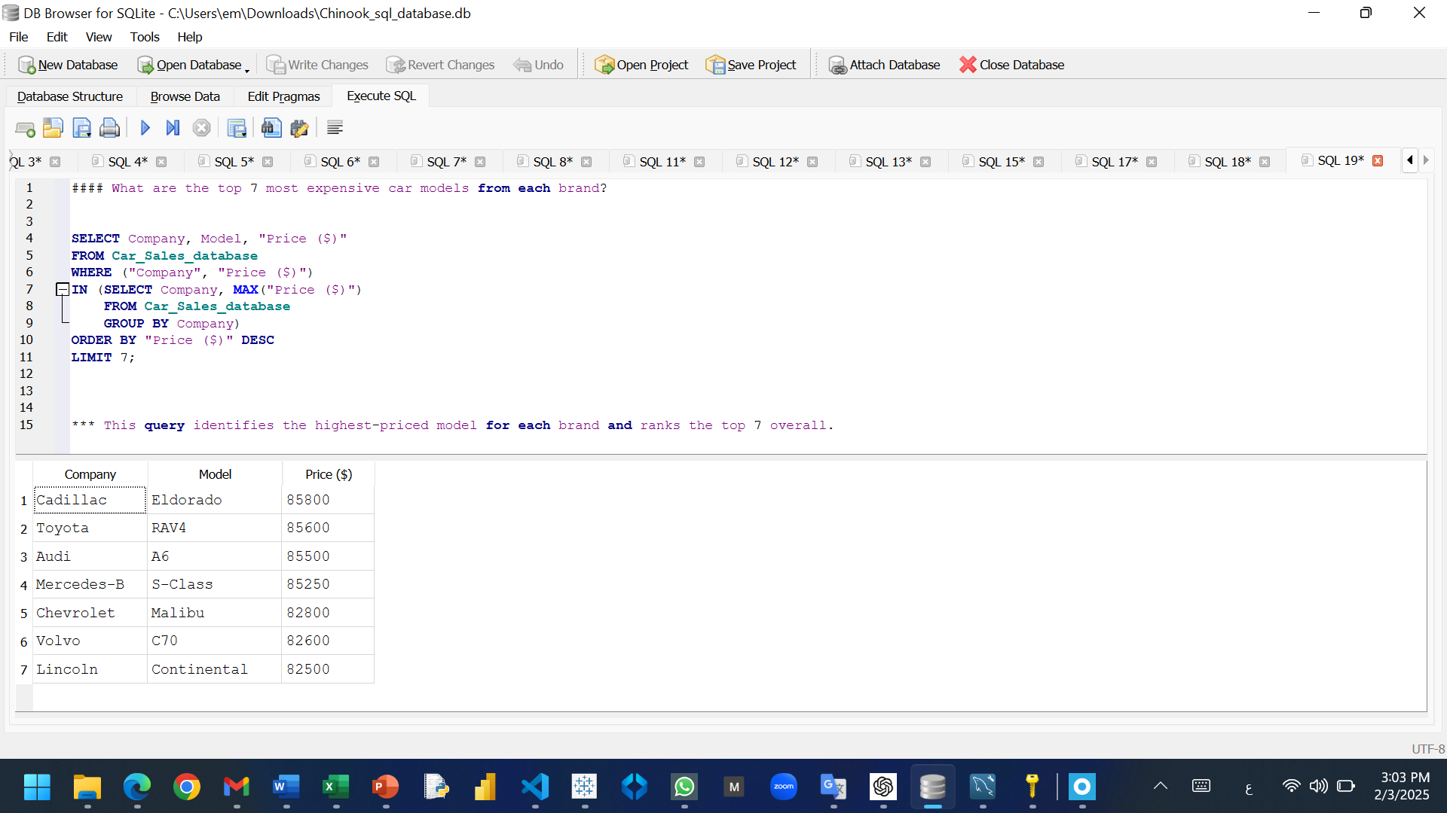
Questions Answering by SQL.

Slide 13
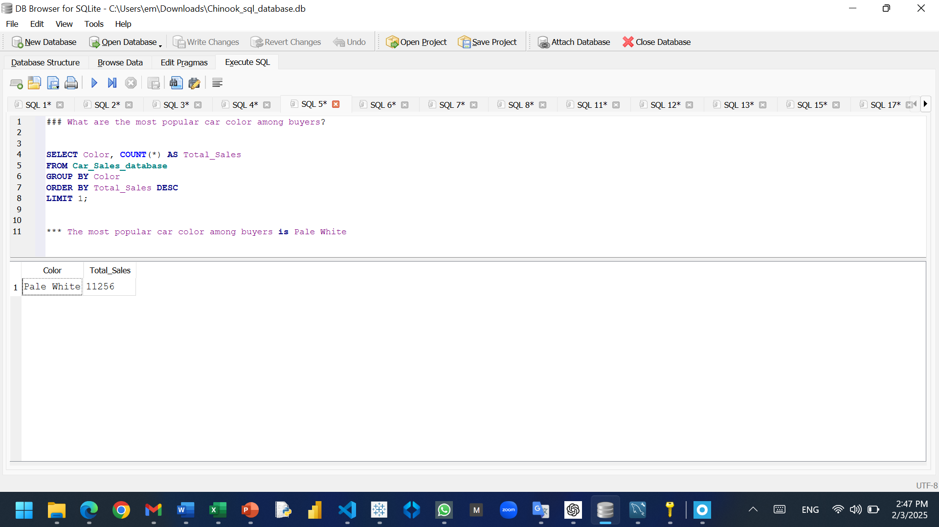
Questions Answering by SQL.

Slide 14
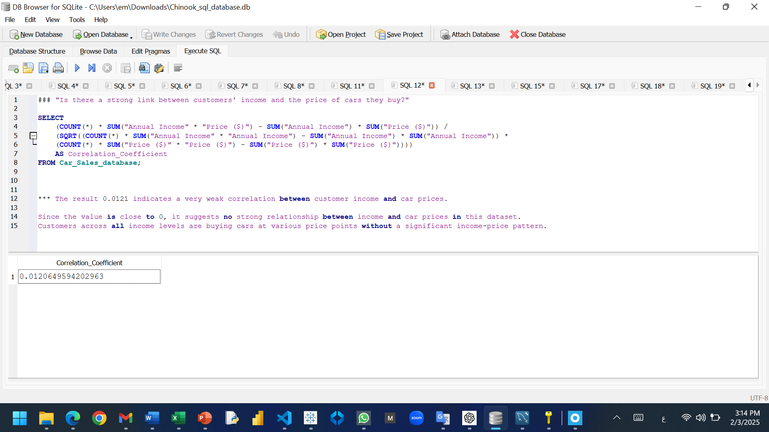
Questions Answering by SQL.

Slide 15
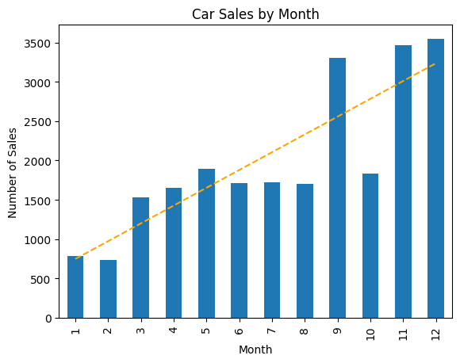
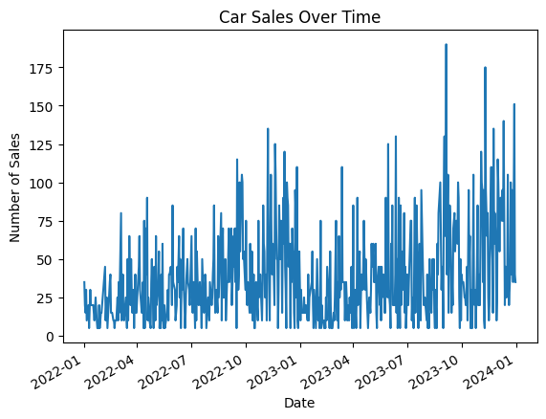
Sales trends change over time

Slide 16
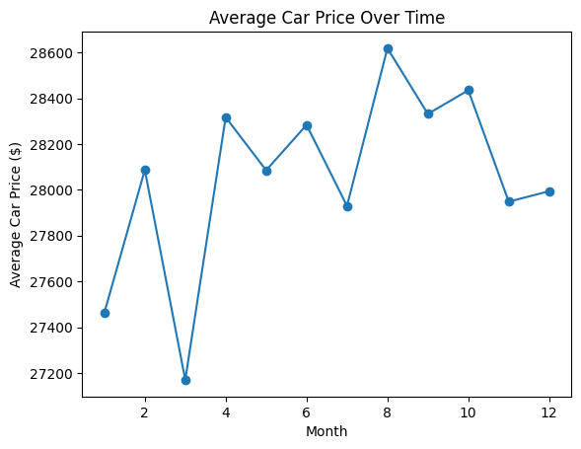
The average car prices over time.

Slide 17
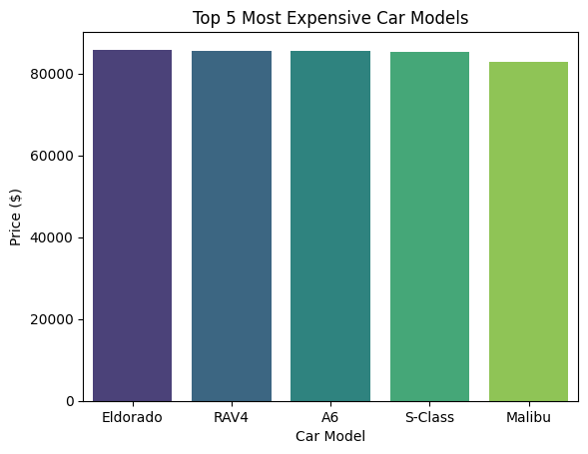
The top 5 most expensive car models.

Slide 18


